Slide 1
Year 10 ASSEMBLY: Pathway and course overview

Slide 2
Why are we having this assembly?
You will have to select a Senior School pathway next term.
We want you to make an informed and considered decision.

Slide 3
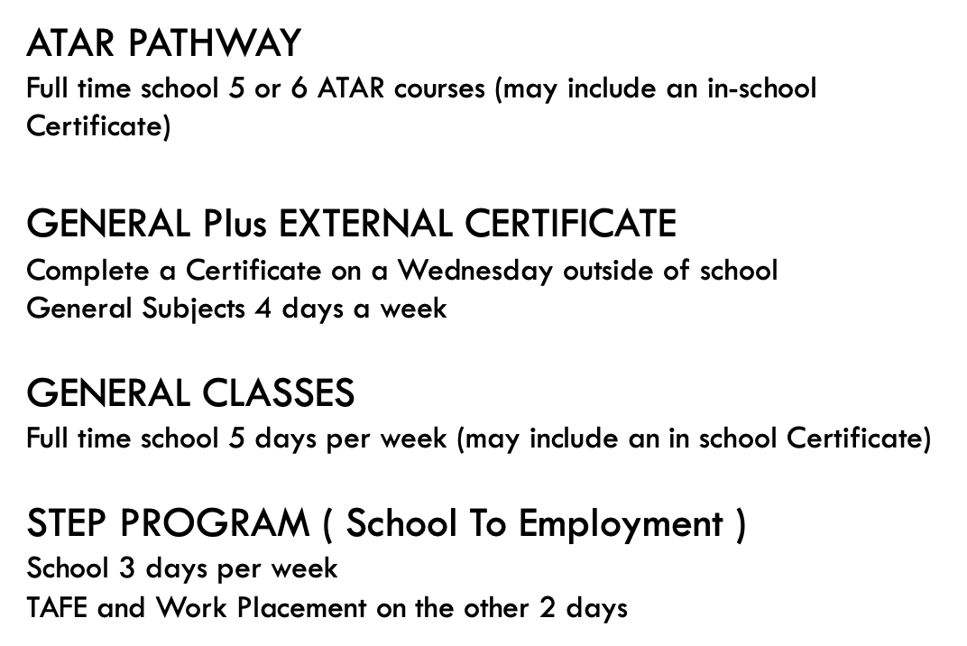
Senior School pathways at comet bay

Slide 4
What courses do we offer?

Slide 5
Science year 11 ATAR Courses:
Course | Course overview | Year 10 achievement needed | University/career links
ATAR Biology | Abiotic and biotic ecosystem, systems for data collection, comparison, and evaluation, cell systems and multicellular organisms. | Min B in Year 10 Science | Biologist, zoologist, conservation, marine, environmental, agricultural
ATAR Chemistry | Energy changes, chemical reactions and the use of chemical equations. Bonding models and the relationship between structure, properties and reactions, unique properties of water, acids and bases, and the use of chemical equations to calculate the concentrations and volumes of solutions involved in chemical reactions. | Min B in Year 10 Science | Chemist, pharmacist, forensics, engineering
ATAR Human Biology | Body systems, reproductive systems, genetic material and gene expression. | Min B in Year 10 Science | Nurse, doctor, physiologist, occupational therapist
ATAR Physics | Energy production, transfer and transformation within thermal, nuclear and electrical physics. Linear motion and wave models. | Min A in Year 10 Science | Physicist, engineer, sonographer, radiologist, pilot

Slide 6
Science year 11 General Courses:
Course | Course Overview | Year 10 achievement needed | University / careers links
Gen Human Biology | Structure and function of cells help to sustain life processes, and the role of the digestive system and how the dietary decisions we make can affect the functioning of body cells and our quality of life. Students explore circulatory, respiratory, and urinary systems, and how they facilitate the exchange, transport and removal of materials and explore the importance of regular health checks to prevent or manage medical problems. | None | Nurse, phlebotomist, pathologist
Gen Science in Practice: Sustainability and Forensic Science | Sustainability, environmental science, chemistry and data management. Forensic science through collection of evidence, evidence types, evidence analysis (fingerprinting, blood, DNA, handwriting, drugs and trace evidence). | None | Environmental science, lab technician, work health and safety representative
Cert II in Sampling and Measurement | Data recording, storage, simple calculations, and result presentation. | Min. C grade in Year 10 Science | Sample collection and laboratory skills across industries such as mining, food manufacturing, construction, and pharmaceutical production.

Slide 7
HASS year 11 ATAR & general Courses:
Course | Course Overview | Year 10 achievement needed | University/career links
General Ancient History | The study of ancient history provides an opportunity for students to study people from cultures and communities that no longer exist, and to investigate how these communities responded to the problems and challenges of their time. | None | Career options include government positions, NGOs, teaching, journalism and the media, tourism, heritage consultancy and planning, museums, libraries, archives, public history, and project management.
ATAR Modern History | By studying ATAR Modern History you’ll gain a range of transferable skills, from informed citizenship and critical thinking, to research and general awareness. What’s more, the knowledge acquired through the study of history is relevant in a wide range of disciplines and can lead to diverse employment opportunities. | Year 10 A/B | Career paths include government positions, NGOs, teaching, journalism and the media, tourism, heritage consultancy and planning, museums, libraries, archives, public history, and project management.
General Politics and Law | Politics and law provides a foundation for active and informed citizenship, promotes social justice while fostering critical thinking and analytical skills. | None | Career paths include government positions, NGOs, teaching, journalism and the media.

Slide 8
HASS year 11 ATAR & general Courses:
Course | Course Overview | Year 10 achievement needed | University/career links
General Psychology | Psychology is the study of the mind and behaviour. Studying psychology provides insights into human behaviour, cognition, and emotions, fostering self-understanding, enhancing communication skills, facilitating personal growth. If you love to understand why we do what we do or analyse how others behave in a group situation then Psychology is for you. | None | Career paths in areas such as counselling, research, forensic criminology or healthcare. There is also options to complete a double degree with Business and Psych and work in Human Resource Management.
ATAR Psychology |  | Year 10 A/B
General Careers and Enterprise | Career and Enterprise General course aims to provide students with the knowledge, skills and understanding to enable them to be enterprising and to proactively manage their own careers. | None | Careers and Enterprise links with real world application to help you stand out whilst applying for jobs. You learn how to create your resume so that you stand out amongst others when applying for jobs: from casual to fulltime.

Slide 9
HASS year 11 ATAR & general Courses:
Course | Course Overview | Year 10 achievement needed | University/career links
General Geography | Geography is the study of the Earth's landscapes, environments, and the relationships between people and their surroundings. It encompasses the physical features of the Earth such as landforms, climate, vegetation, and bodies of water, as well as human aspects including populations, cultures, economies, and political systems. | None | Potential geography job opportunities: urban planning environmental science international relations business
ATAR Geography |  | Year 10 A/B
ATAR Economics | Economics is designed to equip students with the necessary knowledge, skills and techniques to understand the behaviour in the world of commerce and finance. | Year 10 A/B | Potential economics job opportunities: Business development manager Social enterprise owner/director Policy director Financial consultant Philanthropist Economic governance analyst Economic analyst Statistical analyst Risk manager Managing director Auditor

Slide 10
math year 11 ATAR & general Courses:
Course | Course overview | Year 10 achievement needed | University/career links
Math Applications | Algebra, matrices, shape and measurement, and consumer arithmetic (earning and managing money) | B grade in Year 10 Maths | Engineering, Business & Commerce
Math Methods | Probability, statistics, algebra, trigonometric functions | A grade in Year 10 Maths | Engineering, Physicist, Computer Science
Math Specialist | Currently run through SIDE. Must be enrolled in Math Methods. | A grade in Year 10 Maths | Engineering, Physicist, Computer Science

Slide 11
Math Courses continued:
Course | Course overview | Year 10 achievement required | University/career links
Math Essentials | Percentages, measurement, graphs, rates and ratios, time and motion | Pass CAT 1 in OLNA Numeracy | Teaching, nursing, electrician
Math Foundation |  | * You are required to do this course if you have not passed OLNA | All careers

Slide 12
English year 11 ATAR & general Courses:
Course | Course overview | Year 10 achievement needed | University/career links
English ATAR | This course develops students' literacy, critical thinking and communication skills, and the ability to analyse and compose texts across diverse genres and mediums. | B+ | Teaching, journalism + any degrees / careers that require critical thinking and excellent writing skills.
Literature ATAR | The Literature course is divided into novel studies, poetry and drama. It invites students to closely examine representations in literature and apply their understandings of the world to interpreting texts. | B+ | Teaching, journalism + any degrees / careers that require critical thinking and excellent writing skills.
General English | The course focuses on consolidating and refining the skills and knowledge needed by students to become competent, confident and engaged users of English in everyday, community, social, further education, training and workplace contexts. | Pass CAT 1 in OLNA Reading & Writing | Teaching, nursing, administration jobs
General Literature | This course is a fantastic option for those who enjoy English and creative subjects but aren't on the ATAR pathway. The course allows students to draw on their creative talents and enjoy reading picture books, novels and poetry with other like-minded creative students. | C | Teaching, journalism, author, editor, film and Arts industries

Slide 13
Course | Course overview | Year 10 achievement needed | University/career links
General Courses
Visual Arts General | The Visual Arts course is a combination of Arts theory and practice. You will learn how to convey ideas about human experience through paint, drawing and other mediums. | - | Graphic Design Professional Artist Illustrator Tattoo Artist Interior Design Architect
Drama General | In the Drama course you will learn performance techniques as well as learning how to design costumes and set design. You watch live theatre performances and work with industry professionals (this year the focus is on stage fighting and prosthetic make up!). | - | Actor, director Stage director Make-up Artist Prop Making Stagehand
Media General | The Media course gives students the chance to work in teams and individually to produce a short films, radio and documentaries. You will film in locations outside of the school – including Fremantle Prison, Northbridge Graffiti lanes and | - | Film maker Marketing Human resources Social media manager Advertising

Slide 14
Course | Course overview | Year10 achievement needed | University/career links
ATAR Courses
Visual Arts ATAR | The course is a combination of Arts theory and practice. You will learn how to convey ideas about human experience through paint, drawing and clay. | B in Visual Arts | Professional Artist Illustrator Tattoo Artist Interior Design Architect
Media ATAR | The Media course gives students the chance to work in teams and individually to produce a short films, radio programmes and documentaries. You will film in locations outside of the school – including Fremantle Prison, Northbridge Graffiti lanes and Cockburn Ice Arena. | B in English | Film maker Marketing Journalist Advertising
Certificate Courses
Certificate II in Creative Industries | Work with Mr Potts to create 3D models inside of Virtual Reality. We will also be producing films and working with AI technology. There is also a Media Camp and | - | Animator Game design Film maker
Certificate II in Music | The Cert II in Music gives you the chance to develop your musical expertise and stage presence. Learn about the music industry and careers. | - | Musician Audio Engineer DJ Cruise Ship Entertainment

Slide 15
TECHNOLOGIES year 11 ATAR & general Courses: Home Economics
Course | Course overview | Year 10 achievement | University/career links
Textiles | A hands-on course where you learn the skills needed to create your own garments of clothing and accessories. | Nil. | Fashion Stylist, Designer, Fashion Producer.
Food Science | Learn the science behind the foods we cook and consume. | Nil. | Chef, Hospitality Industry jobs.
Children, Family and Community | Learn about the development of children with hands-on experience in the community. | Nil. | Childcare, Nannying, Social Work.
Certificate II Hospitality. | Hands-on experience learning skills that directly lead into the Hospitality sector. | C in English | Chef, Hospitality Jobs

Slide 16
TECHNOLOGIES year 11 ATAR & general Courses: Design and Technology
Course | University/career links
Dimensional Design - CAD | Engineer, architect
Wood | Carpenter
Metals | Electrician
Design Graphics | Graphic Designer, Advertising
Design Photography | Graphic Designer, Advertising
Engineering - Mechanical | Engineer, automotive

Slide 17
Health & Phys Ed. year 11 ATAR & general Courses:
Course | University/career links
Physical Education Studies | Teacher, sports coach
Health Studies | Nurse, Aged Care worker
Cert II Sport Coaching | Teacher, sports coach
Cert II Outdoor Recreation
ATAR Health Studies | Nurse, social worker, community services, aged care

Slide 18
Important dates coming up
Career Week: Term 2, week 1
Careers information through Homeroom: Term 2, week 2 onwards
Parent information night: Term 2, week 4
Course selections through SSO: Term 2, week 5

Slide 19
Who to see if you have more questions?
Questions about STEP– Ms. Bryer in the VET Demountable
Questions about ATAR or General courses:
Ms. Bryer, Ms. Vukman, or any of the Learning Area Deans.
Advice about pathways:
Mrs. Bryer, Ms. Vukman, Mr. Mcloughlin or Ms. Vipond

